Slide 1

Lab 3.3 Actor-Critic Algorithm
Notes:
1

Slide 2
Objectives
The implementation of the Actor-Critic algorithm applied to a simple grid world environment.
Lab 3.3 Actor-Critic Algorithm
2
Notes:
2

Slide 3
Lab Guide Coding
Using given code
We define a simple grid world environment where the agent can move between four states. The goal is to reach the final state, where a reward is received.
We implement an Actor-Critic agent with separate actor and critic networks using PyTorch.
Lab 3.3 Actor-Critic Algorithm
3
Notes:
3

Slide 4
Lab Guide Coding
Using given code
The agent interacts with the environment, selects actions based on the current policy, and updates the actor and critic networks using the observed experiences.
We train the agent on the grid world environment and plot the actor and critic losses as well as the episode rewards over training episodes.
Lab 3.3 Actor-Critic Algorithm
4
Notes:
4

Slide 5
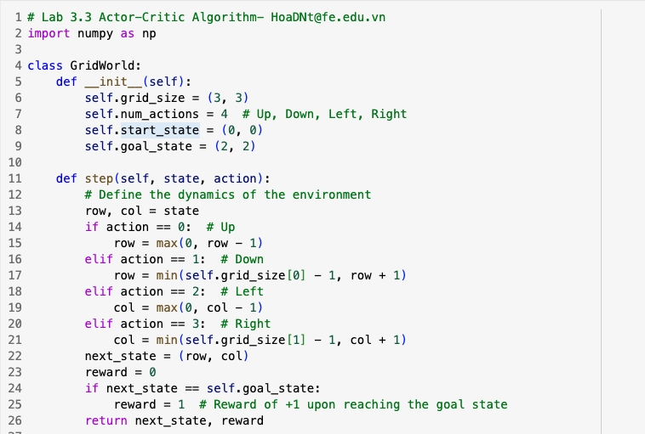
Lab Guide Coding
Lab 3.3 Actor-Critic Algorithm
5
Notes:
5

Slide 6
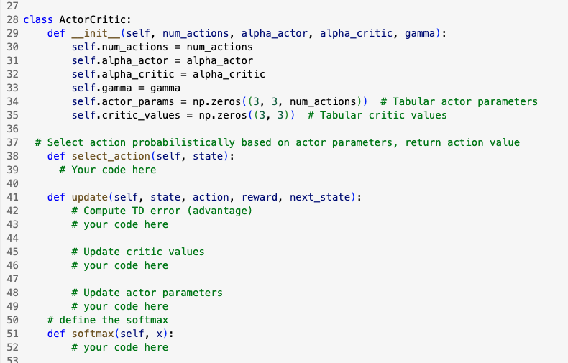
Lab Guide Coding
Lab 3.3 Actor-Critic Algorithm
6
Notes:
6

Slide 7
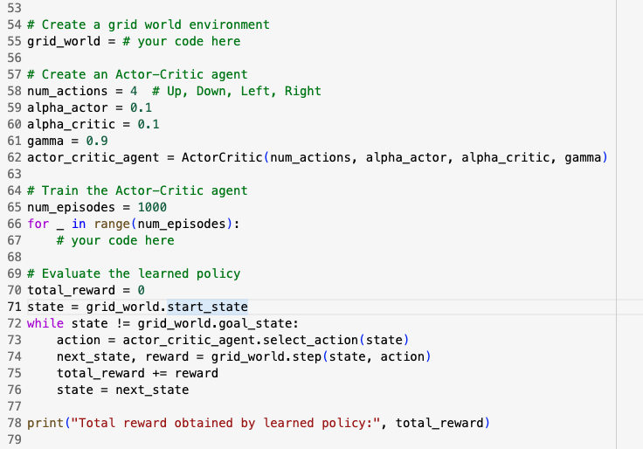
Lab Guide Coding
Lab 3.3 Actor-Critic Algorithm
7
Notes:
7

Slide 8
Q & A
Lab 3.3 Actor-Critic Algorithm
8

